Slide 1
Solutions Investigation
Year 7 Science

Slide 2
Review
What did you change (to see its effect)? Units?
What did you measure as the result? Units?
What did you keep the same to make it a fair test?
Was there anything that was hard to control?
Other than sugar, what else could you test to see its effect on the speed of the skittles rainbow?

Slide 3
Learning Intentions
Mixtures, including solutions, contain a combination of pure substances that can be separated using a range of techniques.

Slide 4
Success criteria
Complete your results table (use other groups’ if you don’t have enough data).
Graph your results and complete the questions in the task booklet.
(If not finished today, take home to complete by next Friday 17/5)

Slide 5
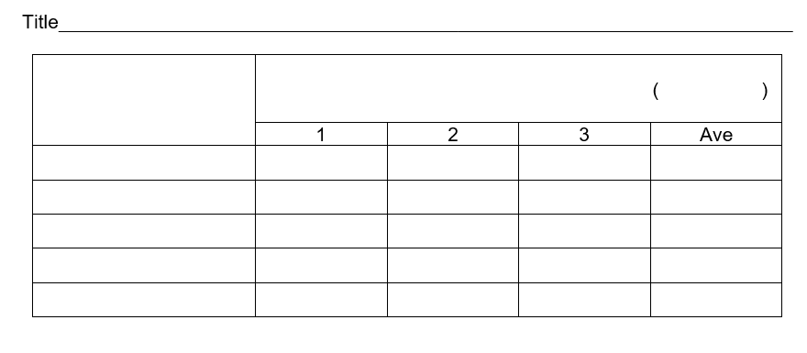
Solubility Investigation (5%)

Slide 6
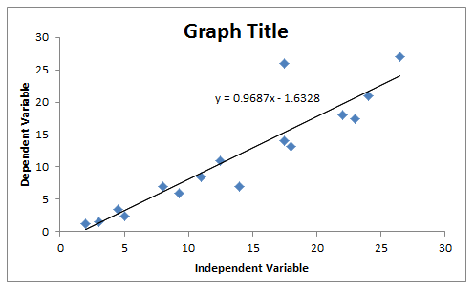
Graphing your results

